Slide 1

Getting Started with PowerPoint 2007
Information Classification: Internal Use Only

Slide 2
Objective
Create an effective and quality presentation using Microsoft PowerPoint 2007.
Notes:
MS PowerPoint Training Handbook
© AIG Systems Solutions

Slide 3
MS PowerPoint – Getting Started
A presentation package that will enable you to produce slides, notes and handouts for any talks, lectures or presentations.
It allows you to vary the format and media for your presentation between A4 acetates; 35mm slides and on-screen slide shows.
There are a number of useful formatting tools included in the package which, used judiciously, can enhance the look of your presentation.
PowerPoint also offers a range of options for animating and customising your presentations.
PowerPoint is relatively easy to learn, particularly if you have experience using a word processing package, and it is surprisingly easy to create colourful presentations with a plethora of fancy animations and other effects.
Notes:
MS PowerPoint Training Handbook
© AIG Systems Solutions

Slide 4
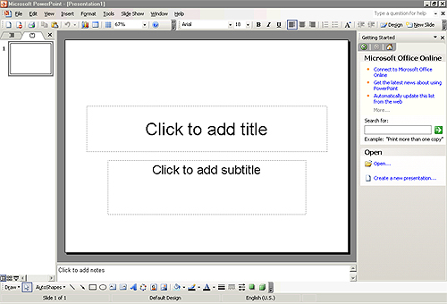
The PowerPoint Environment
To launch PowerPoint, use Start | Programs | PowerPoint
The slide is shown in the centre.
Below it is a Notes pane for adding speaker notes.
To the right is the Task pane, which allows you to carry out certain basic operations or choose selected options.
On the left is the Slide and Outline tabs, which let you quickly, switch to different PowerPoint views.
Menu bar
Toolbar
Outline tab
Slides tab
Shortcut
view icons
Drawing toolbar
Notes pane
Slide
Task pane
The Menu bar, and Toolbar (which includes Standard and Formatting tools) should be visible at the top of the screen, and the Drawing toolbar should be visible at the bottom of the screen.
Notes:
MS PowerPoint Training Handbook
© AIG Systems Solutions

Slide 5
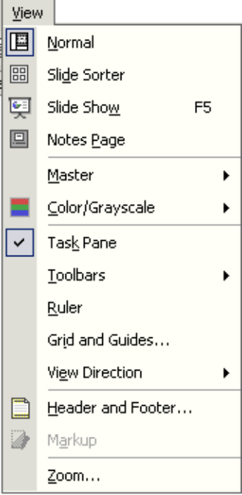

Views
Views allow you to see presentations in a number of different ways. The available views are Normal, Slide Sorter, Notes Page and Slide Show. They are easiest to understand using an existing PowerPoint presentation.
To change a view, either choose one of the four options from the top part of the View menu (shown on the right), or use one of the three shortcut icons at the bottom of the PowerPoint window (below).
Normal View
Slide Sorter View
Notes Page View
Task Pane
Normal view
Slide
Sorter
Slide
Show
Notes:
MS PowerPoint Training Handbook
© AIG Systems Solutions

Slide 6
Getting Help – F1
There are several ways to obtain help in PowerPoint similar to Microsoft Word and Excel.
Offline Help
Online Help
Auto Tile
Keyword Search
Tutorial (Training)
Presentations
Communities
Downloads
Accessibility Help
Online Content Setting
Notes:
MS PowerPoint Training Handbook
© AIG Systems Solutions

Slide 7
Creating Presentations – New Presentation Task Pane
Blank presentation
Design template
Auto Content
New from existing presentation
Photo Album
New from Template
Notes:
MS PowerPoint Training Handbook
© AIG Systems Solutions

Slide 8
Adding New Slides and Choosing Layouts
Choosing a layout
Text Layouts
Content Layouts
Text and Content Layouts
Other layouts
Blank Slide Layout
Applying a different slide layout - using Slide Design Task pane
Notes:
MS PowerPoint Training Handbook
© AIG Systems Solutions

Slide 9
Entering Text
Entering text within a placeholder
Promoting and demoting bullets
Moving bullets up and down
Entering text in a text box
Entering links to Web pages
Notes:
MS PowerPoint Training Handbook
© AIG Systems Solutions

Slide 10
Editing your Presentation
Select the content:
  Single click – to place the cursor on the content
  Double click – to select a word
  Triple click – to select the entire content within the place
  holder
Cut
Copy
Paste
Delete
Spell Check – Ignore, Ignore All, Change, Change All, Add, Suggest, Autocorrect
Notes:
MS PowerPoint Training Handbook
© AIG Systems Solutions

Slide 11
Formatting Slides
Formatting governs the shape, appearance, size and colour of the content. The content has to be selected before formatting can be applied.
Bold, Italics, Underline, Font, Font Size, Font Color, Change case, Applying other text effects, Aligning text, Line spacing, Text Box formatting, text box fill color, line color, Modifying bullet and numbering styles, Inserting symbols, etc.
Increase font size
Decrease font size
Font box
Font size box
Notes:
MS PowerPoint Training Handbook
© AIG Systems Solutions

Slide 12
Using Design Templates
The easiest way to apply wholesale changes to the appearance of all aspects of a presentation (text, layout and colour scheme) is to apply a different Design Template.
Applying a design to a new presentation – Using Slide Design Task Pane
Applying a design to an existing presentation – From Design Template using New presentation task Pane
Notes:
MS PowerPoint Training Handbook
© AIG Systems Solutions

Slide 13
Editing and Moving Slides
Adding new slides – Insert | New Slide or Ctrl + M
Duplicating slides - Insert | Duplicate Slide
Deleting slides – Edit |Delete Slide or press Del
Moving between slides – Use Page Up, Page Down, Home, End keys, Scroll Bars
Using Slide Sorter view
Selection of Multiple Slide – Use Ctrl Key and select the required slides.
To Select All – Ctrl A
Notes:
MS PowerPoint Training Handbook
© AIG Systems Solutions

Slide 14
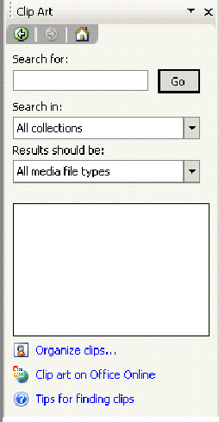
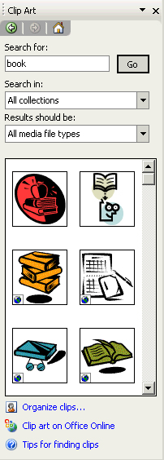
Incorporating Graphics
Using menu – Insert
Using Clip Art Task Pane
Using Content Auto Layout from Slide Layout Task pane
Inserting image from a file – Insert |Picture
Editing graphics – Move image, rotate, re-size, place border, etc.,
Picture toolbar
Once you have inserted an image or Clip Art into your presentation, the Picture toolbar appears, offering options for modifying the graphic as indicated:
Less contrast
Less bright-ness
Recolor picture
Set Transparent Colour
Colour
Rotate
Reset picture
Insert picture
More contrast
More bright-ness
Crop
Line style
Compress picture
Format picture
Notes:
MS PowerPoint Training Handbook
© AIG Systems Solutions

Slide 15
Running a Presentation
A slide show can be started in several ways. One way is to save a presentation in such a way that whenever you open it, it always starts as a slide show. – PowerPoint Show
Another way is to start a slide show from within PowerPoint.
Alternatively, you can create a shortcut on your desktop and start the slide show from there.
You may either start the slide show from the beginning of the presentation (slide 1) or from the current slide.
You can also set up a self-running presentation, at a kiosk or booth, for example, that will run in an ever-repeating loop.
Notes:
MS PowerPoint Training Handbook
© AIG Systems Solutions

Slide 16
Running a Presentation (Contd..)
Starting the slide show from the beginning
Choose View | Slide Show or press the F5 key on the keyboard.
The slide show will commence at slide 1.
Starting the slide show from the current slide
With your presentation open on your screen, ensure you are positioned on the slide you want to start with. Click the Slide Show button in the lower-left corner of the presentation window.
Starting a Slide Show from your desktop
In My Computer or Windows Explorer, locate the file you want to open as a slide show.
Right-click the file name, and then click Show or create a shortcut on your desktop and start the show from there.
Save a presentation to always open as a slide show - .pps
Notes:
MS PowerPoint Training Handbook
© AIG Systems Solutions

Slide 17
Running a Presentation (Contd..)
Controlling the Presentation Manually by
To move to the next slide:
Click with mouse
Press Enter, Page Up key or → Key on the Keyboard
Press the Space Bar key
Press N
Clicking the arrow symbol at the bottom left of your screen, or right-clicking with your
mouse over the slide to reveal the shortcut menu and select Next.
To move back to the previous slide:
Press Backspace, Page Down, or ← on the keyboard,
Press P (for previous),
Right-click with the mouse to display the shortcut menu and select Previous.
Notes:
MS PowerPoint Training Handbook
© AIG Systems Solutions

Slide 18
Slide Show Controls
When you’re running a slide show, you have the following controls:
To Do this
Advance to the next slide Click the mouse
Return to the previous slide Press Backspace
Go to a slide Type the slide number, and then press Enter
Black or unblack the screen Press B
White or unwhite the screen Press W
Show or hide the arrow pointer Press A
Stop/Restart Automatic Show Press S
End slide show Press Esc
Erase drawing on-screen Press E
Go to next slide, if it's hidden Press H
Rehearse with new timings Press T
Rehearse with original timings Press O
Notes:
MS PowerPoint Training Handbook
© AIG Systems Solutions

Slide 19
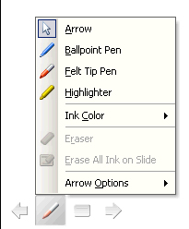
Slide Show Control (Contd..)
To Do this
Rehearse with mouse-click advance Press M
Return to the first slide Hold both mouse buttons down for two seconds
Change pointer to pen Ctrl+P
Change pen to pointer Ctrl+A
Hide pointer and button Ctrl+H
Hide pointer and button always Ctrl+L
Display shortcut menu Right mouse click
Helpful Hint:
You can press F1 during a slide show to see the list of controls.
You can select the pointer, pen and ink colour by clicking the arrow symbol at the bottom-left of your screen, or right-click with your mouse over the slide to reveal the shortcut menu.
Notes:
MS PowerPoint Training Handbook
© AIG Systems Solutions

Slide 20
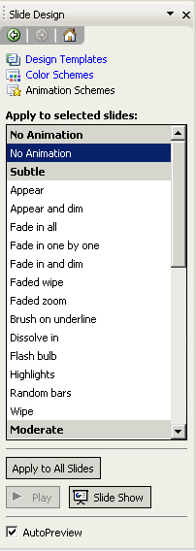
Applying Animations or Builds
Animations (known as Builds in older versions of PowerPoint) apply to the content of slides.
Animations may be applied to the current slide, to all slides, or to selected slides.
Using the Slide Design – Animation Schemes Task Pane
Using Slide Show Menu
To Remove an Animation
Click on the No Animation option (at the top of the list)
Click Apply to All Slides unless you only wish to remove the effect from
the current or selected slides.
Notes:
MS PowerPoint Training Handbook
© AIG Systems Solutions

Slide 21
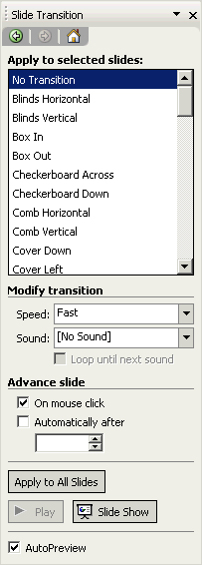
Applying Slide Transitions
Transitions determine how a slide appears on screen.
Applying appropriate Transition Effect in Slides
Using the Slide Sorter View
Using the Normal View - Menu Slide Show | Slide Transition
Using the Slide Transition Task Pane
Notes:
MS PowerPoint Training Handbook
© AIG Systems Solutions

Slide 22
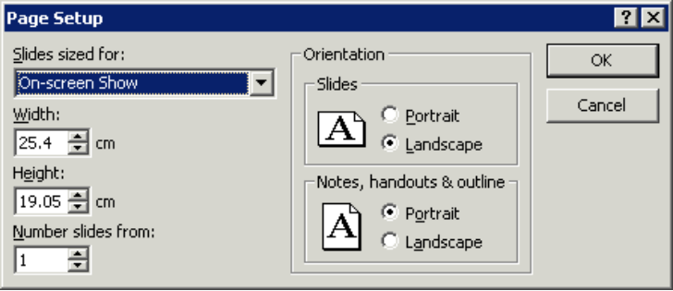
Printing Slides
In PowerPoint you can print out slides, speaker’s notes, outlines and handouts in a range of different formats. First set the Page Setup options.
Page Setup
Choose File | Page Setup.
Select the size from the Slides sized for option, or specify a size using the Width and Height boxes.
Specify the paper Orientation for Slides, and for Notes, Handouts and Outlines. Normally slides will be in Landscape orientation for on-screen delivery.
Notes:
MS PowerPoint Training Handbook
© AIG Systems Solutions

Slide 23
Printing Slides …Contd.
Choose File | Print to display the Print dialog box.
Select the correct printer in the Name box.
Specify the slide range you want to print in the Print range section.
Specify how many copies you want in the Copies box.
The Print what box allows you to choose to print your presentation in the following formats:
Slides — to print with one slide per page (normally landscape). You may print the whole presentation, the current slide or specify slide numbers. You can choose whether to have any animations printed or not (printing with animations is not recommended as each build within each slide will be printed on a separate sheet).
Handouts — for the audience. They are a snapshot of the slides within your presentation. You can specify whether to have two, three, six or more slides per printed page.
Notes — Notes pages will print each slide together with the speaker notes.
Outline View - Outline prints each slide in a list format, text only.
If you are using and black and white printer, click the Pure Black and White checkbox.
Click OK.
Notes:
MS PowerPoint Training Handbook
© AIG Systems Solutions

Slide 24
Activity
Create a PowerPoint presentation specific to any topic in your project / work incorporating all the features learned in Module 1.
Evaluation Criteria
Professional Flow of the presentation
Usage of appropriate features.
Choice of using appropriate features. (Shortcut, Menu, Task Panes, etc)
Explanation of the same.
Minimum of 10 slides to be present.
Notes:
MS PowerPoint Training Handbook
© AIG Systems Solutions

Slide 25
Thank You
Notes:
MS PowerPoint Training Handbook
© AIG Systems Solutions

